Slide 1
Battle of Neighborhood's
Discovering Places ideal to move in according to the requirements specified by the customer.
By Yashasvi Pamu
Presentation made under IBM’s Professional Data Science Certification Coursera Capstone Project .

Slide 2
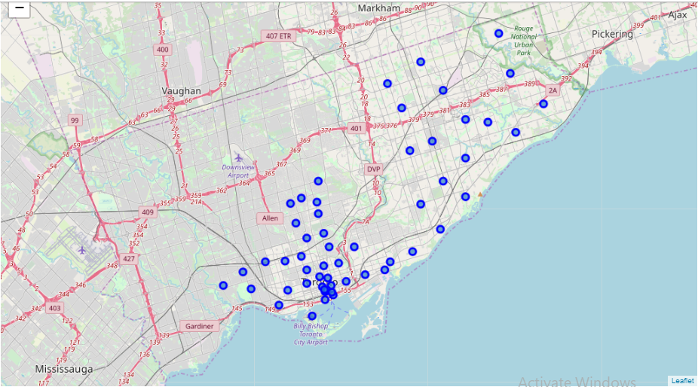
Business Problem
Finding an ideal place to move in with all the amenities you need is no longer a dream or an hard task as we can get all the details through online websites which show us the houses and the amenities around it online. The below solution is a similar way of finding an ideal solution with the amenities specified by the customer.
Neighborhoods around Toronto and Scarborough

Slide 3
DATA
REQUIREMENT
Data that will be required for solving the problem -
List of all the neighborhoods in Canada.
List of all neighborhoods in the selected locality.
List of all venues in selected neighborhoods.
SOURCE
https://en.wikipedia.org/wiki/List_of_postal_codes_of_Canada:_M
Foursquare API
For Venues in City and in Each locality in selected neighborhoods.

Slide 4
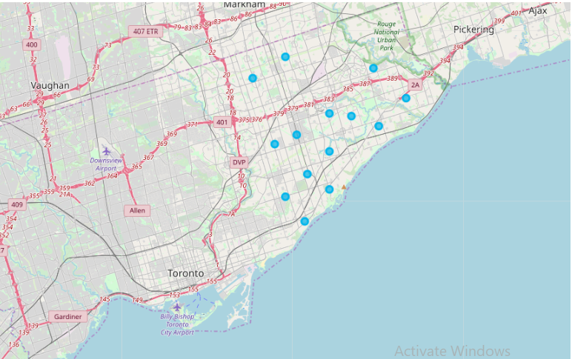
METHODOLOGY
To suggest the best Location ,steps followed are -
Using Beautiful Soup Library Wikipedia pages containing postal codes of neighborhoods in Canada are scraped into Pandas Dataframe.
Dataframe contained data about postal code, Borough, and neighborhoods. Then Dataframe was Cleaned and Processed according to requirement of the problem to be solved. Proper benchmarks were set to obtain the best results.
The List of Venues in a neighborhoods were obtained using Foursquare API and the neighborhood which fulfills the necessary requirements were taken.
With the help of Unsupervised Machine Learning Algorithm (K Means Algorithm) Locality in the neighborhoods were obtained as per the instructions given by the customer.
1
2
3
4

Slide 5
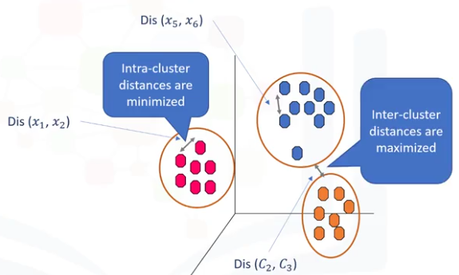
K- Means Clustering (Unsupervised Machine Learning Algorithm)
Unsupervised Learning
Supervise, means to observe, and direct the execution of a task, project, or activity. We do not supervise the model, but we let the model work on its own to discover information that may not be visible to the human eye. It means, the unsupervised algorithm trains on the dataset, and draws conclusions on unlabeled data.
What is a Cluster?
K-Means Clustering
1
A cluster is a group of data points or objects in a dataset that are similar to other objects in the group, and dissimilar to datapoints in other clusters.
2
K-Means is a type of partitioning clustering, that is, it divides the data into K non-overlapping subsets or clusters without any cluster internal structure or labels. This means, it's an unsupervised algorithm.

Slide 6

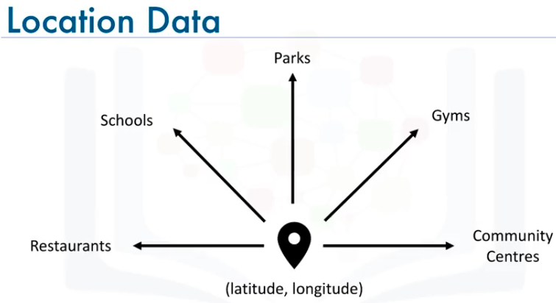
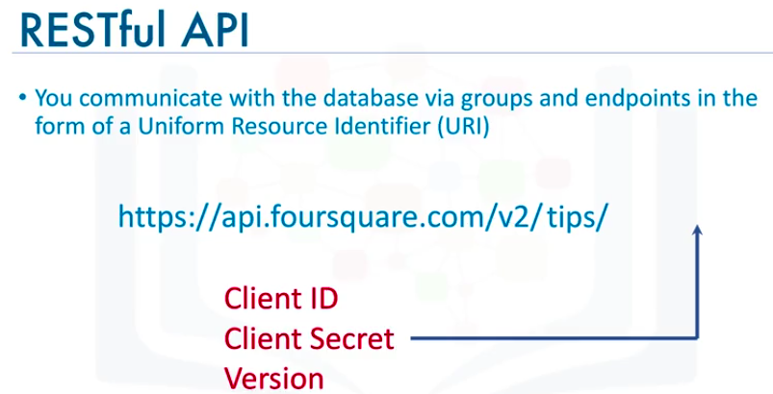
Location Data Provider – Foursquare
1
Location Data
Location data is data describing places and venues, such as their geographical location, their category, working hours, full address, and so on, such that for a given location given in the form of its geographical coordinates (or latitude and longitude values) one is able to determine what types of venues exist within a defined radius from that location.
2
Foursquare
Foursquare is a technologic company that built a massive dataset of accurate location data.
Foursquare powers location data for Apple, Uber, Snapchat, Twitter and many more.
Their API and location data is currently being used by over 100,000 developers.

Slide 7
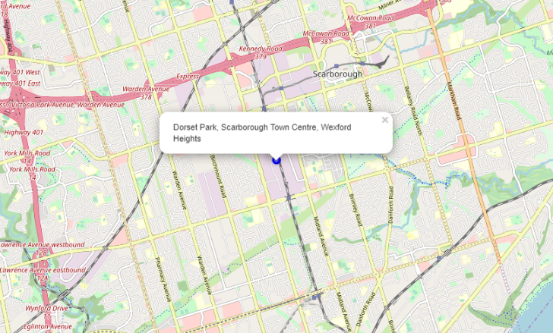
Results
Best spot to shift to in Scarborough with the required amenities is near
Dorset Park, Scarborough Town Centre
Best Locality Scarborough Town Centre–
Wexford Heights

Slide 8
Discussions and Recommendations
1
In the Foursquare API, we have queried the Venues of a locality by specifying the LIMIT and Radius of our choice. We have chosen less LIMIT as the number of API calls that can be done using a free account in Four Square are less.
○ We can increase the limit for more accurate results.
○ We can increase the Radius for more venue results from each city
2
In the venue categories we are choosing only few out of 2000 that are available and finding their ratings to identify the best cluster. Hence, finding ratings and tips must be done relatively for each category and then considering more number of venue categories would actually yield a better output.

